Slide 1

Microsoft Fabric
Real-time Analytics end-to-end workshop

Slide 2
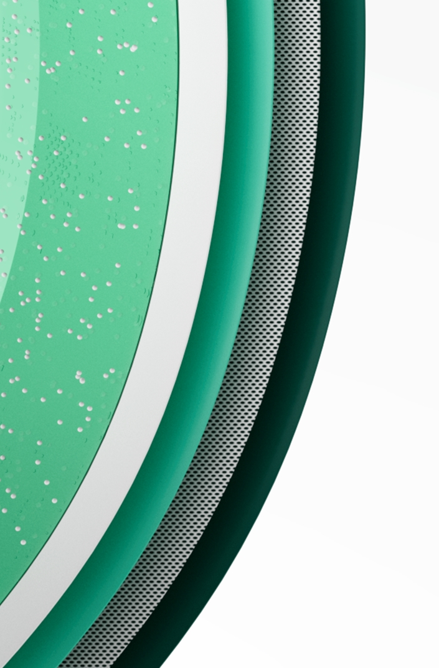
CONTENTS
01
Microsoft Fabric Overview
02
Workshop Introduction
03
Wrap-up, Q&A, and Feedback
Notes:
In the next 30 minutes, we will introduce the new Microsoft Fabric solution and what it has to offer.
We will explore the challenges and opportunities that organizations face while navigating the ecosystem of data, analytics, services, tools, and the necessary business outcomes they support. We will also share how Microsoft Fabric is uniquely positioned to support your organization with a simplified, unified, SaaS-based data and analytics solution.

Slide 3

Microsoft Fabric Overview
1
Notes:
So, how do you enable data-driven decisions, at scale, and integrate them into big picture strategy?
As we’ve seen, research shows that successful integration of both data and analytics improves time to insights and faster value realization. A comprehensive, unified ecosystem that leverages machine learning and artificial intelligence is key for all organizations to achieve success and data modernization.

Slide 4
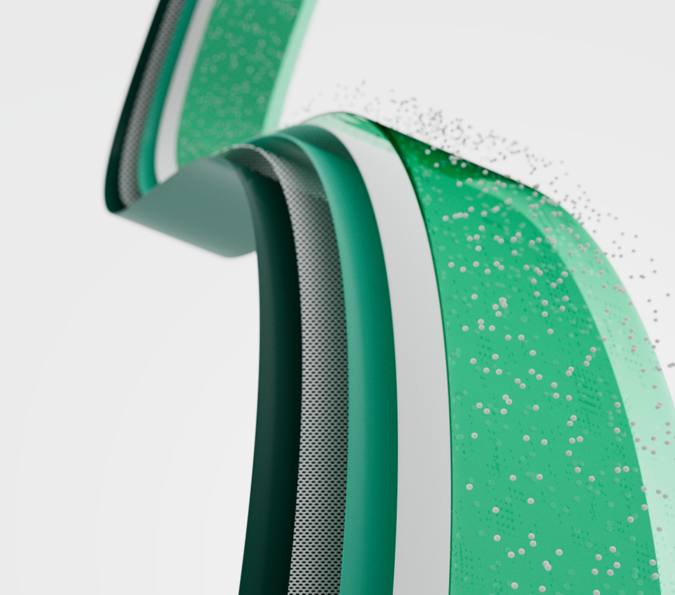

Introducing Microsoft Fabric
Microsoft Fabric enables you to manage your data in one place with a suite of analytics experiences that work together seamlessly, including:
Data Factory
Synapse Data Engineering
Synapse Data Warehouse
Synapse Data Science
Synapse Real-Time Analytics
Power BI
Data Activator
Notes:
Microsoft Fabric provides a one-stop-shop for data integration, data engineering, real-time analytics, data science, and business intelligence needs without compromising the privacy and security of your data. By joining top companies using Microsoft Fabric, you will enable teams to experience an end-to-end, highly integrated, single solution that is easy to understand, onboard, create, and operate.
With this solution you will no longer have to stitch together multiple data, analytics, and BI solutions to get the business answers you need. With this unified SaaS solution, you’ll have a single source of truth for all your data and analytics, enabling secure, democratized insights. By leveraging this powerful open and scalable solution, you’ll accelerate time to value through cost management, spend optimization––making the most of your data investment.

Slide 5

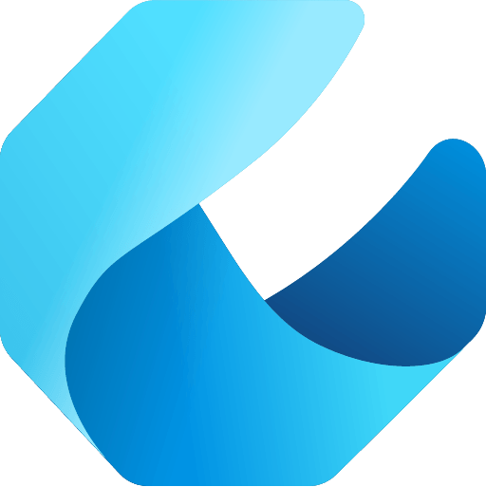

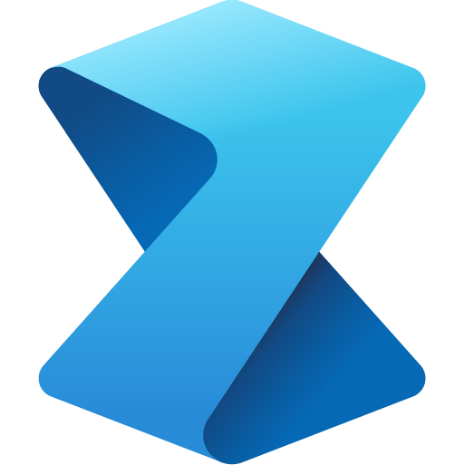

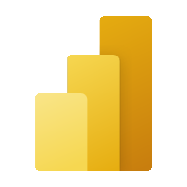


Microsoft Fabric does it all—in a unified solution
An end-to-end analytics platform that brings together all the data and analytics tools that organizations need to go from the data lake to the business user
Data Integration
Data Engineering
Data Warehouse
Data Science
Real Time Analytics
Business Intelligence
Observability
Data Factory
Synapse
Synapse
Synapse
Synapse
Power BI
Data Activator
Unified data foundation
OneLake
UNIFIED
SaaS product experience
Security and governance
Compute and storage
Business model
Notes:
Microsoft Fabric combines Data Factory, Synapse Analytics, Data Explorer, and Power BI into a single, unified experience, on the cloud. The open and governed data lakehouse foundation is a cost-effective and performance-optimized fabric for business intelligence, machine kerning, and AI workloads at any scale. It is the foundation for migrating and modernizing existing analytics solutions, whether this be data appliances or traditional data warehouses.
Talk Track for Greenfield/Growing Analytics Customers – Microsoft Fabric’s SaaS environment makes it easier to deploy an entire end-to-end analytics engine from the ground up at an accelerated pace. With the solution’s built-in security and governance capabilities, you can be rest assured your data and insights are protected.
Talk Track for Existing Synapse Customers – Microsoft Fabric is an evolution of Azure Synapse. You will still be able to enjoy the benefits and limitless scale of Synapse in an easier to use SaaS solution while adopting new capabilities that enhance your entire analytics approach. And with the addition of Power BI, you can help democratize the ability to uncover insights and create interactive reports across the organization, helping everyone make more data-driven decisions in their everyday work.
Talk Track for Existing Power BI Customers – With Microsoft Fabric, you’ll be able to access new and powerful data tools and services like Azure Synapse within the same user experience you already enjoy with Power BI. You can unify these tools with your disparate data sources in the same environment to establish a single source of truth for all data, driving the ability for everyone to uncover more accurate and consistent insights than before. And instead of having to worry about security concerns of a patchwork analytics estate, you can be rest assured your data is protected with the built-in security and governance capabilities.

Slide 6









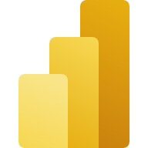



Empower your data professionals to move faster and unlock more value from your data
Data Engineers
Data Scientists
Data Analysts
Data Citizens
Execute faster with the ability to spin up a Spark VM cluster in seconds, or configure with familiar experiences like Git DevOps pipelines for data engineering artifacts
Streamline your work with a single platform to build and operate real-time analytics pipelines, data lakes, lake houses, warehouses, marts, and cubes using your preferred IDE, plug-ins, and tools.
Reduce costly data replication and movement with the ability to produce base datasets that can serve data analysts and data scientists without needing to build pipelines
Quickly tune a custom model by integrating a model built and trained in Azure ML in a Spark notebook
Work faster with the ability to user your preferred data science frameworks, languages, and tools
Bypass engineering dependencies with the ability to use your preferred no-code ML Ops to deploy and operate models in production
Tap into proven-at-scale models and services to accelerate your AI differentiation (AOAI, Cognitive Services, ONNX integration, etc).
Avoid slow, progress-stagnating data wrangling by seamlessly triggering a workflow that can unlock data engineering tools and capabilities quickly.
Accelerate your work with visual and SQL based tools for self-serve data transformations and modeling as well as self-serve tools for reporting, dashboards, and data visualizations
Turn data into impact with industry-leading BI tools and integration with the apps your people use everyday like Microsoft 365
Make more data-driven decisions with actionable insights and intelligence in your preferred applications
Maintain access to all the data you need, without being overwhelmed by data ancillary to your role thanks to fine grain data access management controls
Serve data via warehouse or lakehouse
Serve transformed data
Serve insights via embedding
Supporting experiences:
Supporting experiences
Supporting experiences
Supporting experiences
Data Factory
Data Warehouse
Data Science
Azure ML
Data Warehouse
Real-time analytics
Power BI
Power BI
Microsoft 365
Data Engineering
Real-time analytics
Serve data via warehouse or lakehouse
Data Stewards
Maintain visibility and control of costs with a unified consumption and cost model that provides evergreen spend optics on your end-to-end data estate
Gain full visibility and governance over your entire analytics estate from data sources and connections to your data lake, to users and their insights

Slide 7

Get more done and accelerate time to insights with Copilot in Microsoft Fabric
Turn your words into dataflows and data pipelines so you can intelligently integrate data from anywhere
Get suggestions for code and entire functions in real-time
Get a guided machine learning model creation experience to unlock more insights in your data.
Create and tailor Power BI reports in seconds, generate DAX calculations, create narrative summaries, and ask questions about your data
Even create your own conversational experiences that combine Azure Open AI models and your organization's data and publish as plug-ins.
Most importantly, Microsoft Cloud runs on trust which means your data always remains your data
Notes:
With the disruption of the past few years, there is no secret that technology is a way of future-proofing for tomorrow. To remain resilient, organizations require trusted security and the ability to be agile, especially in today’s rapidly changing climate.
The new Microsoft Fabric solution combines Microsoft Fabric with the power of large language models to help accelerate your organization’s productivity. All of this is done without sacrificing security, as your data is stored encrypted on the cloud – and is not used to train the foundational AI models.
Microsoft Fabric is infused at every layer with experiences designed to help users get more done and unlock the full potential of their data. With Copilot in Fabric in every data experience, users can use conversational language to create dataflows and data pipelines, generate code and entire functions, build machine learning models, or visualize results with stunning Power BI reports at the speed of thought.
For example, when connecting to data, Copilot can turn words into dataflows and data pipelines to help users integrate data from anywhere. For users writing code, Copilot can automatically suggest code and entire functions in real-time in their editor. When creating machine learning models, Copilot can act as a guide to maximize the insights unlocked from data. And with Copilot in Power BI, users can simply describe the visuals and insights they’re looking for and Copilot will do the rest. Users can create and tailor reports in seconds, generate and edit DAX calculations, create narrative summaries, and ask questions about their data, all in conversational language.
Customers can even create their own conversational language experiences that combine Azure Open AI models and their data and publish them as plug-ins. But for all these AI-powered experiences, our customer’s data always remains their data—it will never be used by Microsoft without consent.

Slide 8
Workshop Overview
2
Notes:
So, how do you enable data-driven decisions, at scale, and integrate them into big picture strategy?
As we’ve seen, research shows that successful integration of both data and analytics improves time to insights and faster value realization. A comprehensive, unified ecosystem that leverages machine learning and artificial intelligence is key for all organizations to achieve success and data modernization.

Slide 9
Workshop Schedule – All Day Workshop
Module 0 9:00-9:30 AM
Solution overview and initial setup
Module 1 & 2 9:30-10:15 AM
Module 3 10:15 – 10 :45 AM
Lunch Break 11:30 – 12:30 PM
Module 5 12:30pm – 2:00 PM
Module 6 2:00-3:00 PM
Module 7 3:15-4::30 PM
KQL Databases and KQL Querysets
Power BI Real-time Reports
Synapse Data Warehouse and pipelines
Data Lakehouse with notebooks
Data Science – Building ML models
Break and Review 10:45 – 11:00 AM
Module 4 11:00 – 11:30 AM
Data Activator
Break and Q&A 3:00 – 3:15
Closing 4:30 – 4:45 PM
Feedback and next steps
Notes:
Full day workshop

Slide 10
Workshop Schedule – Half Day Workshop
Modules 1-3 9:00 – 10:00 AM
Solution Overview
Setup
Module 6
10:00 – 11:00 AM
Module 7
11:00 – 12:30 PM
Closing 12:30pm – 1:00 PM
Module 6: Lakehouse
Data Science
Q&A, Feedback, and next steps
Medallion Architecture, notebooks, and data wrangler
Build ML models to predict stock prices
Notes:
Half day workshop example

Slide 11
Workshop Schedule – 3 Day Lunch & Learn
Day 1 Modules 1-3
Setup, KQL, Reports
Day 2 Module 6
Day 3 Module 7
Data Science
Lakehouse
Build ML models to predict stock prices
Solution Overview
Medallion Architecture, notebooks, and data wrangler
Notes:
3 day lunch and learn style

Slide 12
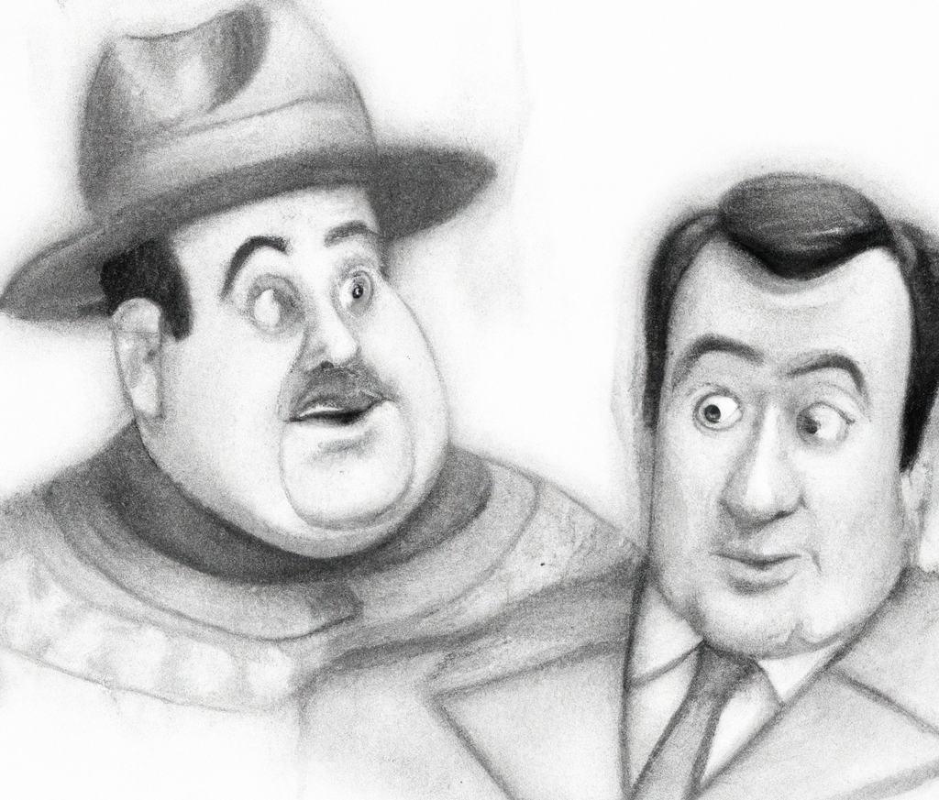
Scenario Overview
AbboCost Financial is a small firm that monitors several volatile stocks. Their current data feed provides stock prices in real time.
Your goal: support the development of this fledgling company by developing data solutions.

Slide 13
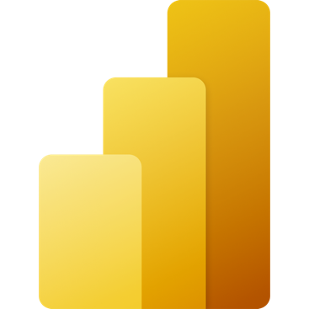
Common Real-time Analytics Patterns
Data Source
Ingestion
Store
Expose
Lakehouse & Data Warehouse
CI & Shortcuts
Kusto DB
PBI
Structured / Unstructured
Pipeline & Dataflows
Kusto Query
Event Streaming
Mirror
Notebook
Lakehouse & Data Warehouse
ML Model
Notes:
Unlike the Data Science, Lakehouse, and Data Warehouse analytics scenarios, streaming data can be ingested into the Microsoft Fabric in several ways to achieve real-time analytics.
Users can leverage Event Hub, IoT Hub, pipelines, dataflows, notebooks, or open-source products like Kafka, Logstash, and more.
Once ingested into the Microsoft Fabric, streaming data can be stored in Kusto DB and mirrored into Lakehouse. After the data has been stored, machine learning models can be trained and tested directly on the Lakehouse with experiments.
Like the other scenarios, business users can analyze and visualize the data with Power BI using the see-through mode or SQL endpoints. Data can also be exposed through KQL or notebooks using Spark.

Slide 14
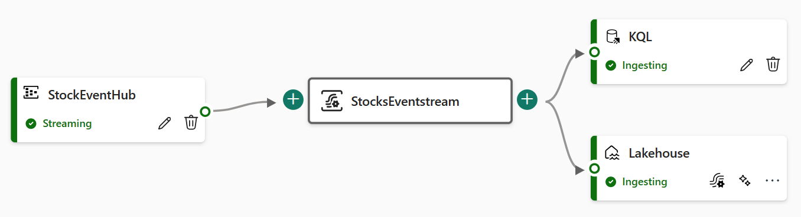
Module 0 – Introduction & Setup
Goals: Understand the solution and deploy the stock price application.
Choice: Decide to deploy the application as an Azure container or run in a Jupyter notebook.
In general, we recommend deploying as an Azure container if possible.

Slide 15
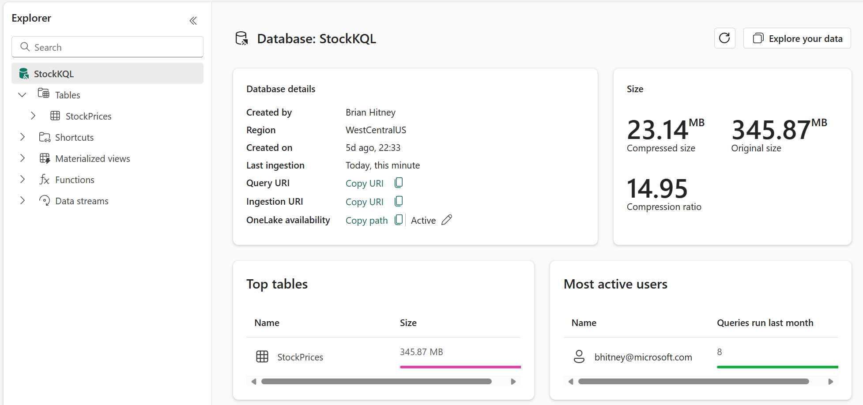
Module 1 – KQL Database Setup
Goals: Create and configure a KQL database to ingest data
With data being fed to the Eventstream, this module focuses on creating and KQL database as a data sink.

Slide 16
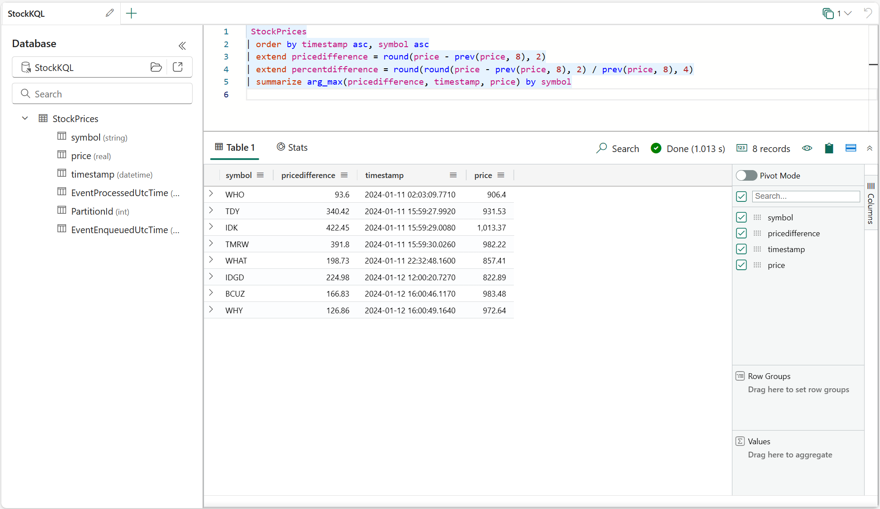
Module 2 – KQL Querysets
Goals: Interact with the underlying data via KQL queries
Begin writing queries to summarize data using Kusto Query Language. Similar to T-SQL, KQL is designed for data exploration and summarization.

Slide 17
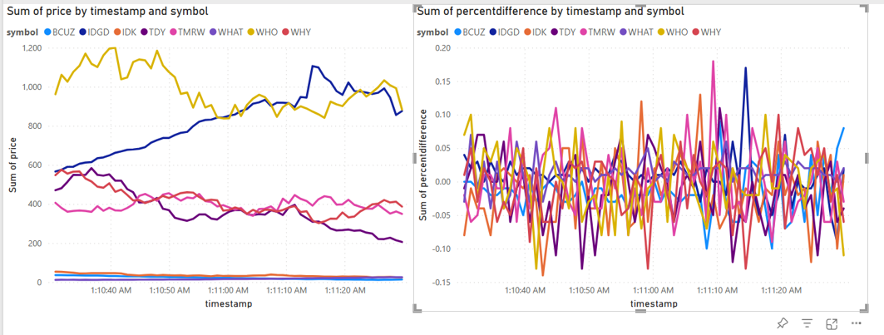
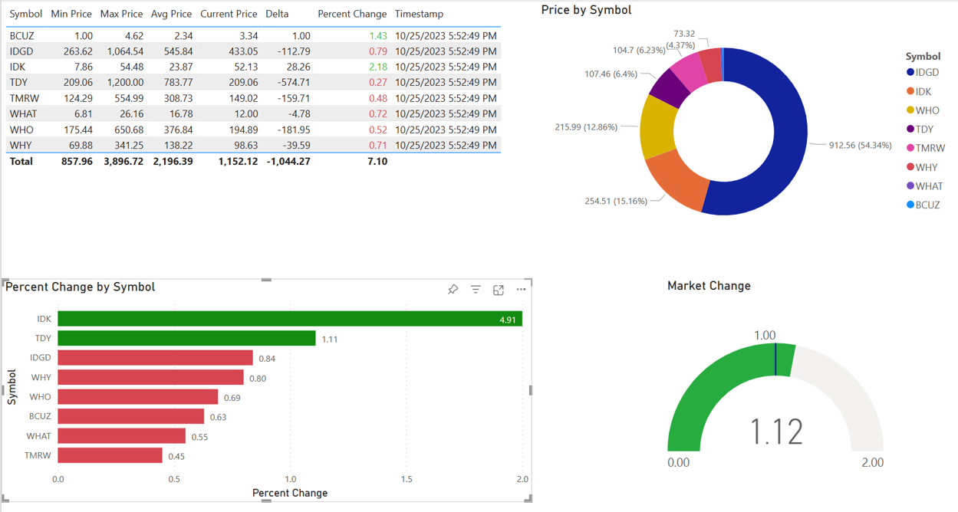
Module 3 – Reports in Power BI
Goals: Build a simple report in Power BI to display real-time data.
KQL is the ideal engine to power fast, real-time dashboards. Using a combination of KQL summarizations and Power BI functions, compelling visuals can be created.

Slide 18
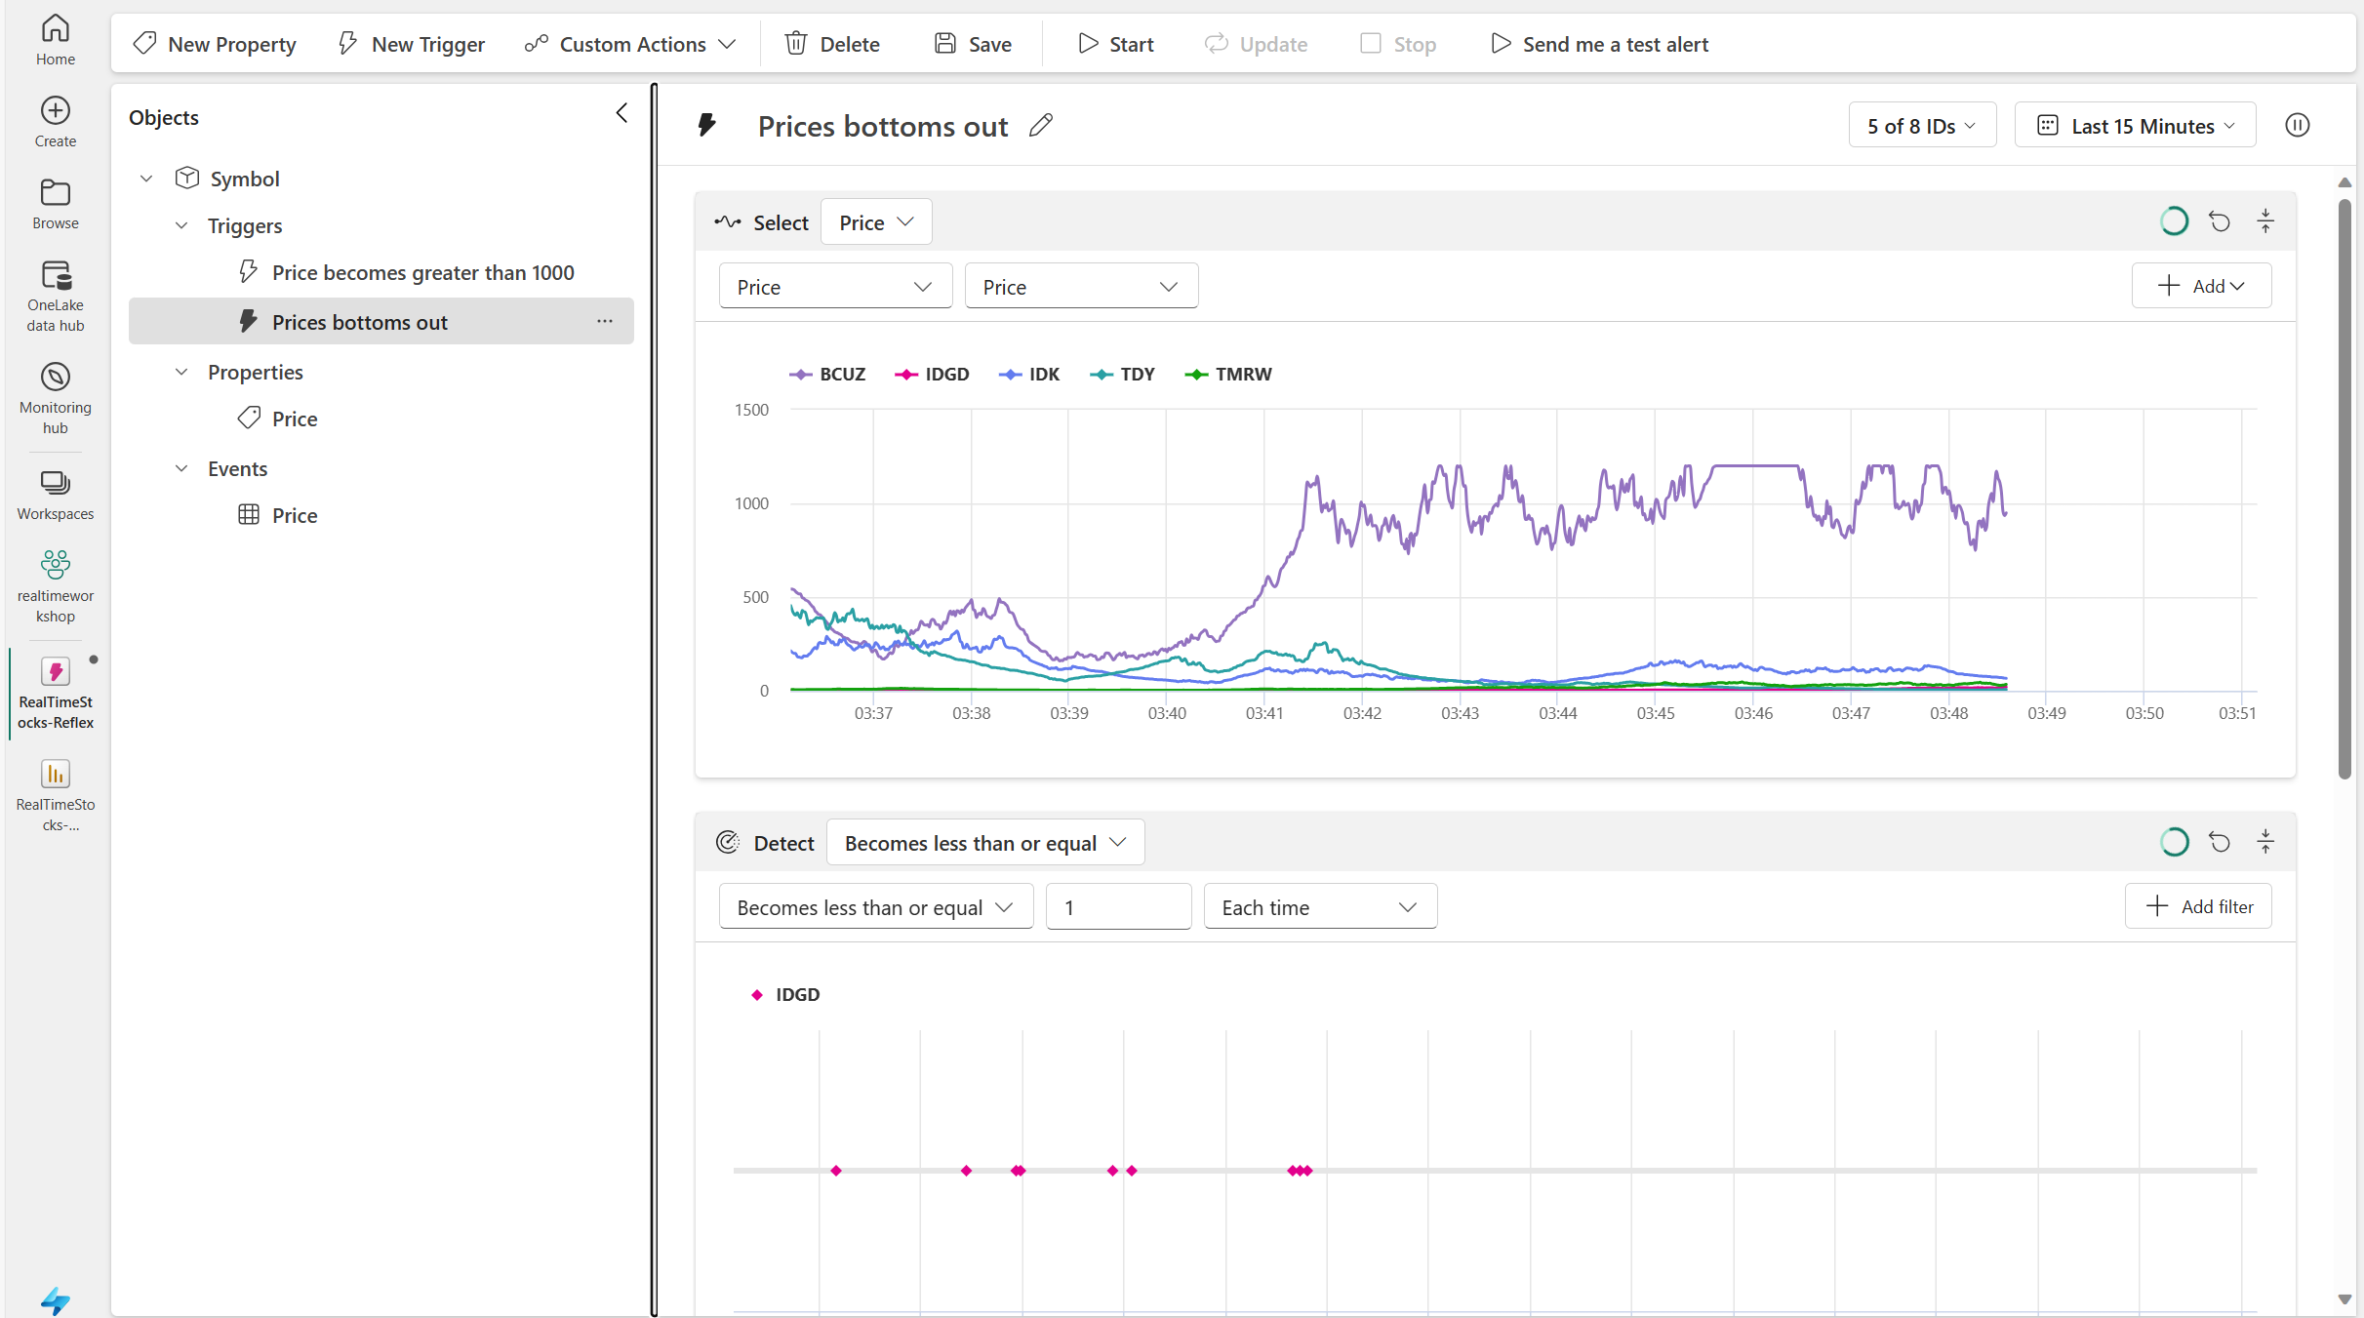
Module 4 – Data Activator
Goals: Configure alerting when prices reach certain levels.
This module will explore the configuration of Data Activator, an observability tool, to generate notifications when conditions in the underlying data are met.

Slide 19
Common Data Warehouse Patterns
Data Source
Ingestion
Store
Expose
Shortcut Enabled
Mounts
Data Warehouse
PBI
Structured / Unstructured
Pipelines & Dataflows
Warehouse
Transform
Procedures
Notes:
The Data Warehouse analytics scenario takes existing sources that are mounted, while pipelines and dataflows can bring in all other data that is needed.
IT teams can then define and store procedures to transform the data, which is stored as Parquet/Delta Lake files in OneLake.
From there, business users can analyze and visualize data with Power BI, again using the see-through mode or SQL endpoints.

Slide 20
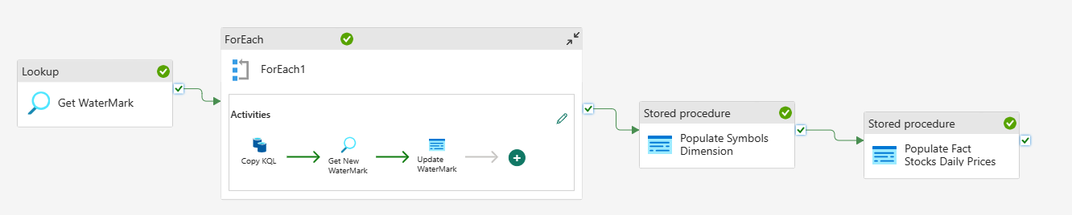
Module 5 – Data Warehouse
Goals: Build a dimensional model and data pipeline that stores aggregated data into a data warehouse.
Using the data warehousing capability, the data will be periodically loaded and summarized into a data warehouse for historic reporting. To accomplish this, we’ll use data pipelines for orchestration of an ETL pipeline.

Slide 21
Common Lakehouse Patterns
Data Source
Ingestion
Store
Expose
Shortcut Enabled
Shortcuts
Lakehouse(s)
PBI
Structured / Unstructured
Pipelines & Dataflows
Lake Warehouse
Transform
Notebooks & Dataflows
Notes:
The Microsoft Fabric Lakehouse analytics scenario makes it so that data can be ingested into OneLake with shortcuts to other clouds repositories, pipelines, and dataflows in order to allow end-users to leverage other data.
Once that data has been pulled into Microsoft Fabric, users can leverage notebooks to transform that data in OneLake and then store them in Lakehouses with medallion structure.
From there, users can begin to analyze and visualize that data with Power BI using the see-through mode or SQL endpoints.

Slide 22
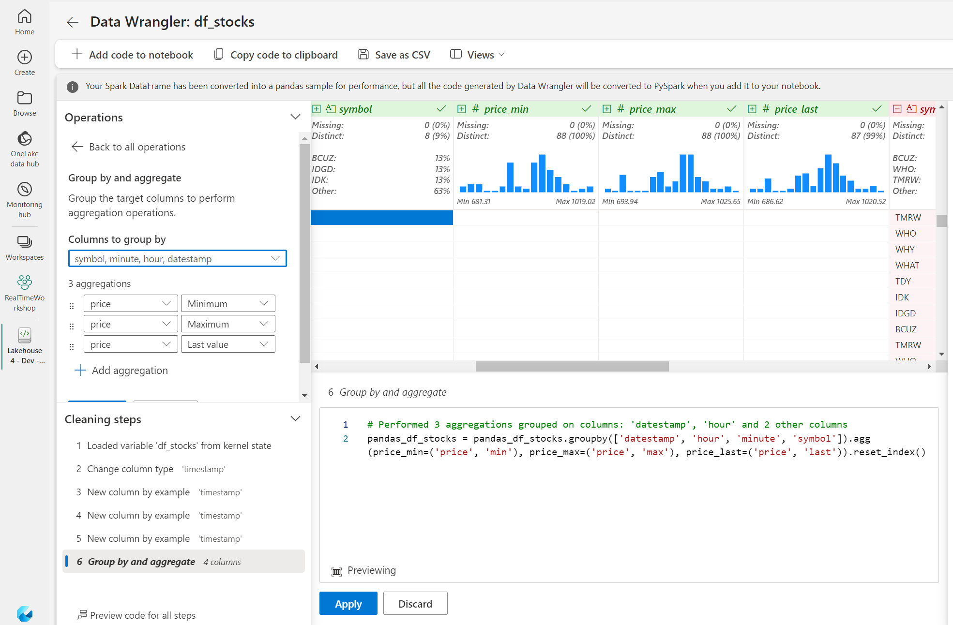
Module 6 – Data Lakehouse
Goals: Create a data lakehouse using data wrangler, notebooks, and Delta tables.
After modifying the Eventstream to copy data to the lakehouse, notebooks and data wrangler will be used to aggregate the data into tables that can be used for reporting and data science.

Slide 23
Common Data Science Patterns
Data Source
Clean & prepare
Store
Expose
Lakehouse & Data Warehouse
Notebooks
Lakehouse(s)
PBI
Train test & apply
Lake Warehouse
Models
Experiments
Notes:
The Data Science analytics scenario can be ingested similarly to the Lakehouse and Data Warehouse paths.
Once the data is ingested, it is cleaned and prepared using notebooks and then stored in the Lakehouse with medallion structure.
After the data is cleaned and stored, machine learning models can be trained and tested directly on the Lakehouse.
Like the other analytics scenarios, business users can analyze and visualize the data with Power BI using the see-through mode or SQL endpoints.

Slide 24
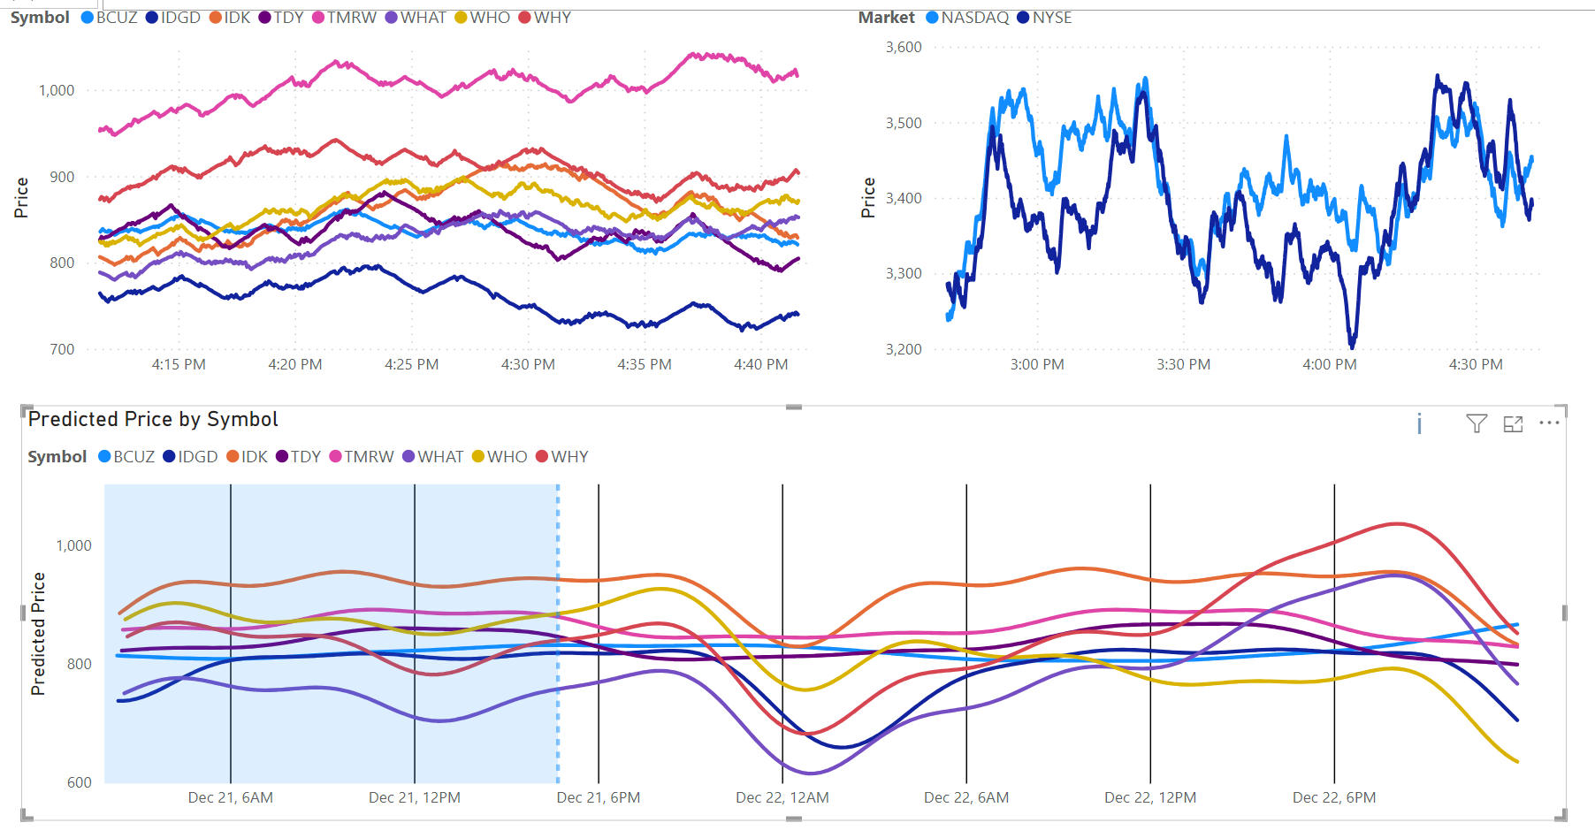
Module 7 – Data Science
Goals: Use notebooks to build an ML model predicting the stock prices.
Using the library Prophet, data will be analyzed allowing for future predictions. These predictions will be stored in the lakehouse and integrated into the reports.

Slide 25
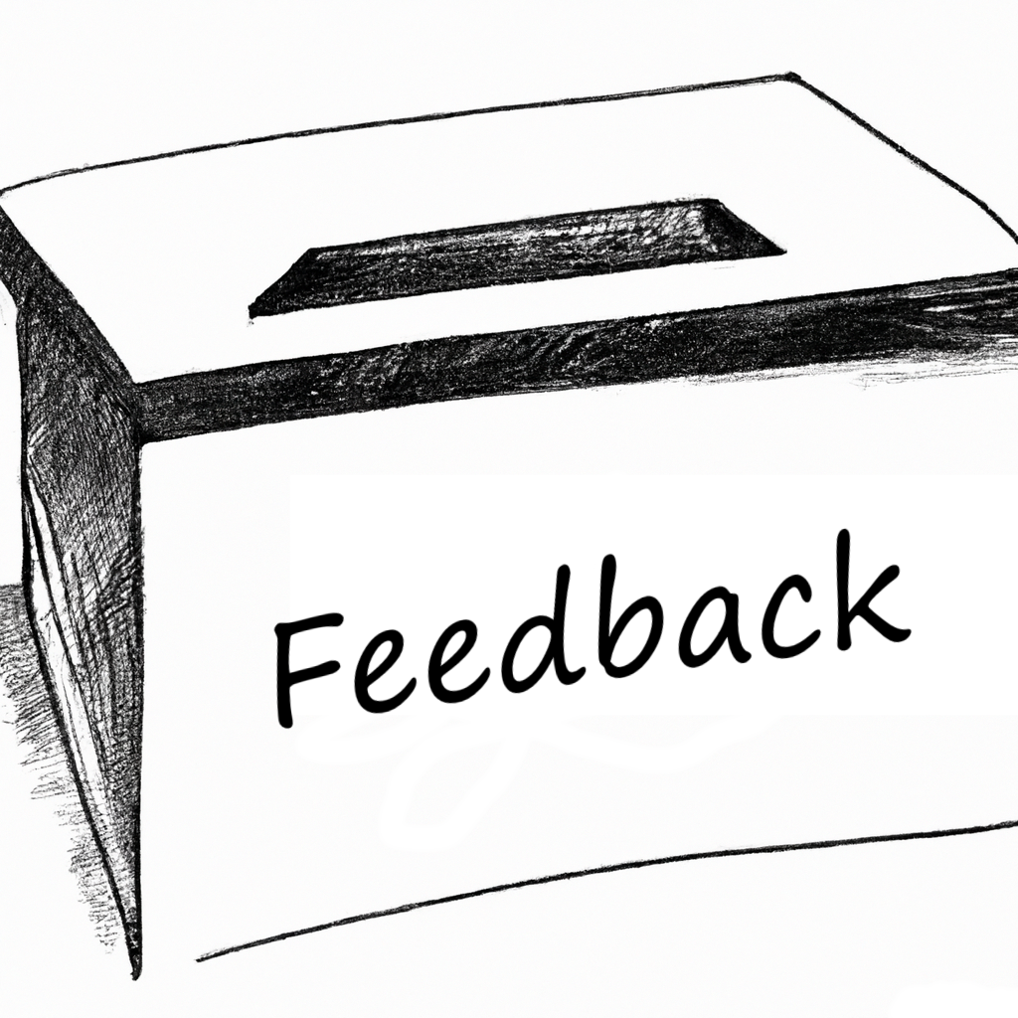
Wrap-up
Thank you for attending! Check out the additional challenges throughout the modules, and the Extras module with unique add-ons.
Comments or suggestions? Please let us know.
Get your questions answered in the Microsoft Fabric webinar series: https://aka.ms/fabric-webinar-series
See the latest announcements in the Microsoft Fabric blog site: https://aka.ms/fabric-tech-blog
Read the implementation guide: https://aka.ms/Getting-Started-eBook

Slide 26

Thank you

